Slide 1
Augmented Lagrangian and Alternating
Direction Method of Multipliers:
Theory, Algorithm, and Applications
Md. Toufiqur Rahman & Rifat Bin Rashid
RUID: 236007519, RUID: 237000174
Department of Electrical and Computer Engineering, Rutgers University

Slide 2
Contents
ADMM Theory & Framework :
The Lagrangian
Dual Function & Dual Problem
Dual Ascent
Dual Decomposition
Augmented Lagrangians and the Method of Multipliers
ADMM: What and Why ?
ADMM Application
ADMM applied to LASSO
ADMM applied to Image Reconstruction
ADMM in precoder

Slide 3
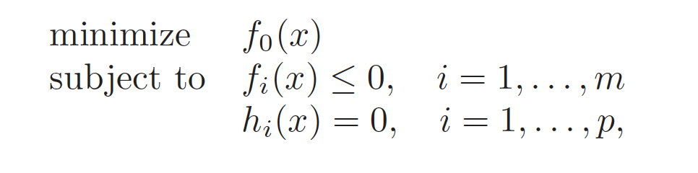
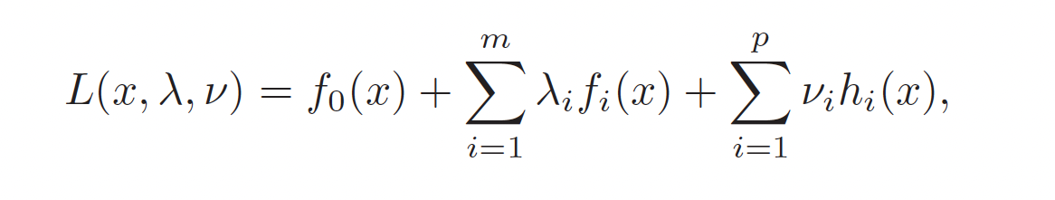
The Lagrangian
Optimization problem in the standard form:
Lagrangian L : R^{n} x R^{m} x R^{p} → R associated with the problem:
The vectors λ and ν : Dual variables or Lagrange multiplier vectors
Main Idea : Turing constrained problems into unconstrained ones by adding a "price" (λ) for violating constraints.

Slide 4

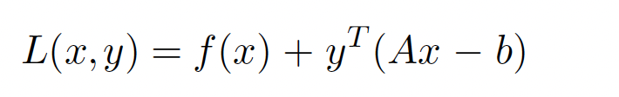
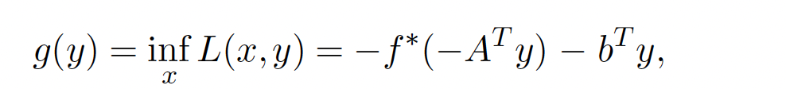

Dual Function & Dual Problem
An equality-constrained convex optimization problem :
The Lagrangian for the problem :
y : dual variable
Dual Function:
Dual Problem:
maximize g(y)
Dual optimal point y*
If f is ‘strictly convex’ :

Slide 5
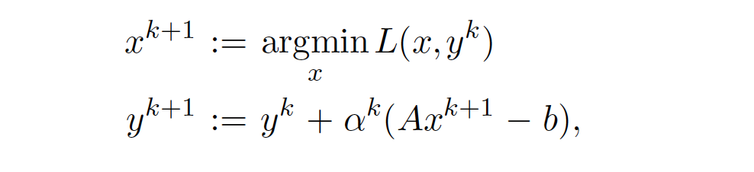
Dual Ascent
Solving the dual problem using gradient ascent (Assuming that g is differentiable)
x⁺ = argmin_{x}L(x,y)
∇g(y) = Ax⁺ − b
Dual Ascent : Iteratively updates both x and y
x-minimization step:
Dual variable update:
With appropriate choice of α^{k}, the dual function increases in each step
g(y^{k+1}) > g(y^{k}) : Dual Ascent
Main Idea : Minimize f(x) while drifting toward Ax=b.
The primal tries to minimize, the dual tries to penalize violations.

Slide 6

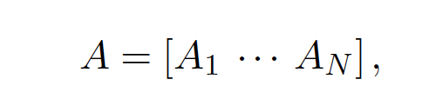
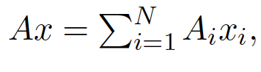
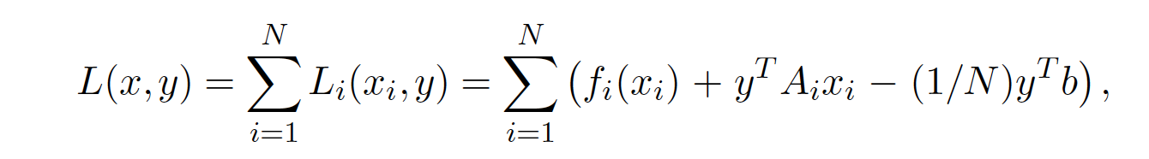
Dual Decomposition:
Objective f is separable :
Constraint matrix A is separable :
So Lagrangian is separable :

Slide 7
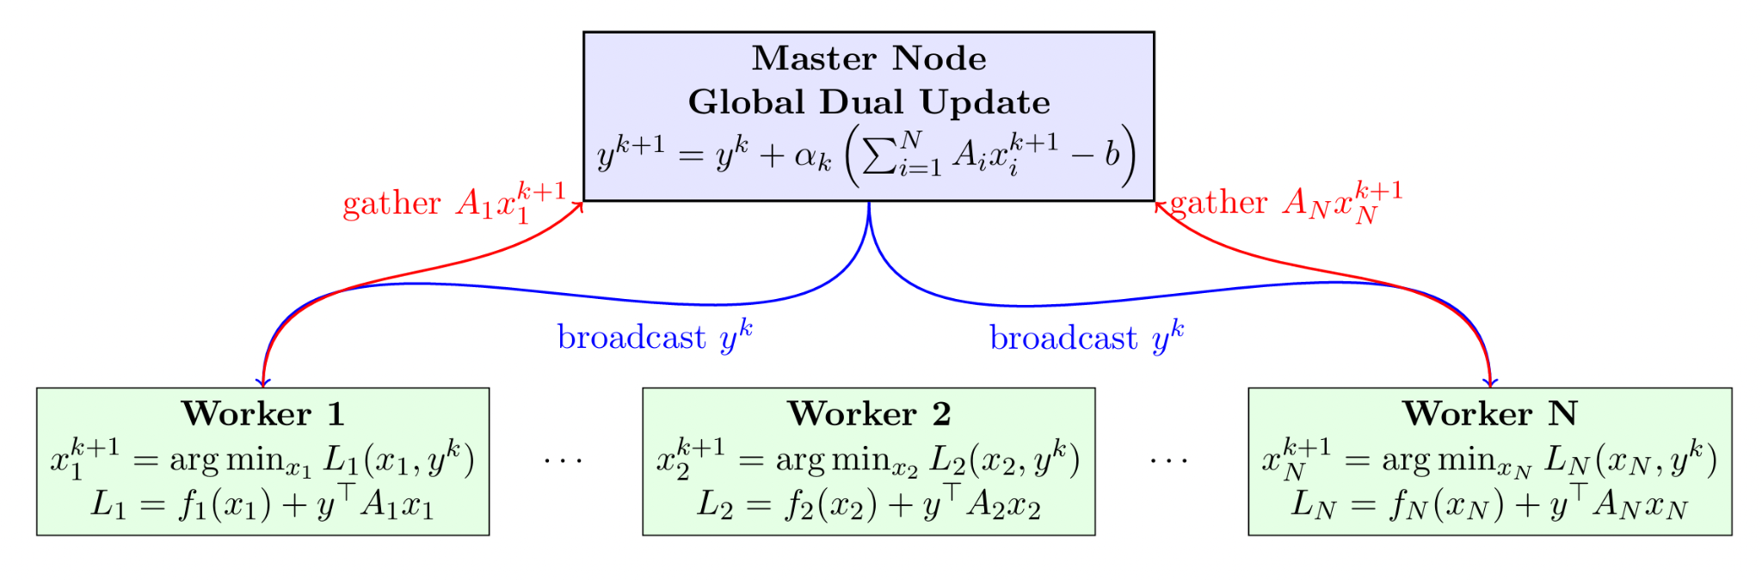
Dual Decomposition Architecture
Broadcast and Gather
Decentralized algorithm
• Master Node: Maintains dual variables y^{k}, performs global updates
• Worker Nodes: Solve local subproblems in parallel using y^{k}
• Broadcast Phase: Master sends y^{k} to all workers simultaneously
• Gather Phase: Workers send their contributions back to master
• Lagrangian: L_{i}(x_{i},y) = f_{i}(x_{i}) + y⊤A_{i}x_{i} for each subproblem

Slide 8
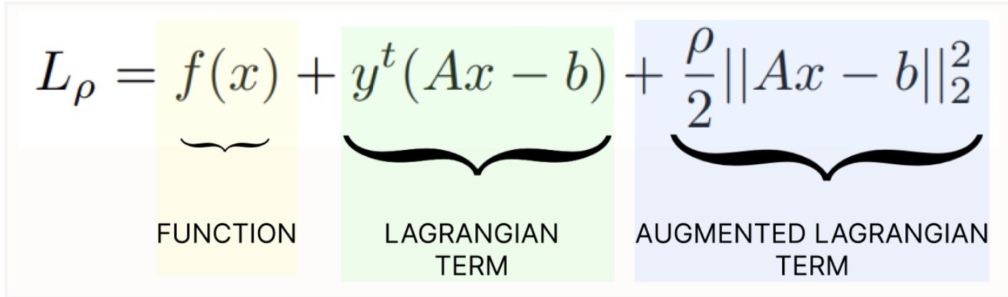
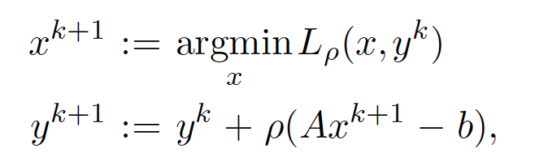
Augmented Lagrangians and the Method of Multipliers
Bringing robustness to the dual ascent method.
Augmented Lagrangian :
Method of Multipliers :
f don't have to be strictly convex!
Cons: L_{ρ} is not separable even when f is separable !
Method of multipliers cannot be used for decomposition!

Slide 9
Solution : ADMM Combines the Best of Both Worlds !
ADMM
Dual Decomposition
Decentralized algorithm!
Method of multipliers
Robustness : f don't have to be strictly convex!

Slide 10
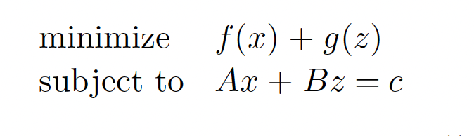
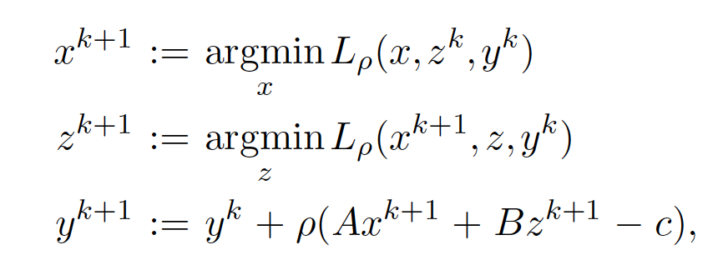
ADMM
Augmented Lagrangian :
x-minimization step :
z-minimization step :
dual variable update :
Alternatingly updating x & z = ADMM

Slide 11
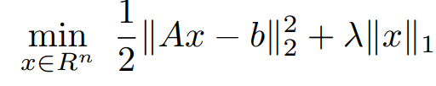
ADMM (example)
The ∥x∥₁ is nonsmooth, and hard to handle jointly with ∥Ax−b∥₂
Solution: introduce a copy of x, let’s call it z, and write:
min⁡_{x,z}∥Ax−b∥₂+ λ ∥z∥₁ subject to x=z
This transforms the problem into ADMM form:
f(x) = ∥Ax−b∥₂, g(z) = λ ∥z∥₁

Slide 12
Applications of ADMM
Case 1: ADMM in LASSO
Case 2:Image Reconstruction Using ADMM for LASSO
Case 3: ADMM in Hybrid Precoding for MIMO Systems

Slide 13
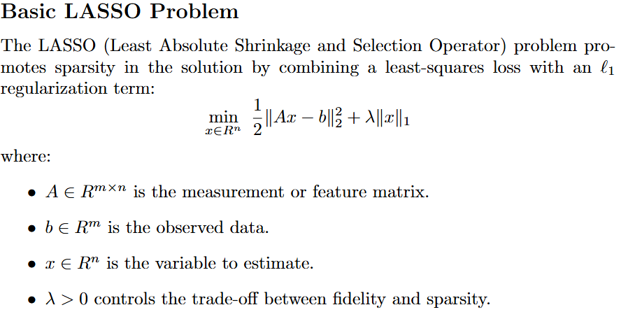
LASSO and ADMM Formulation

Slide 14
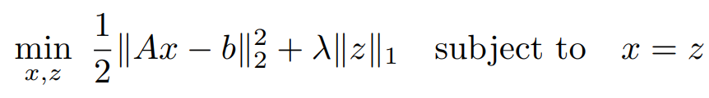
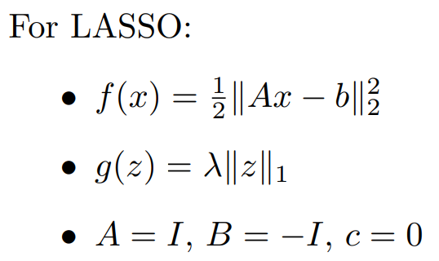
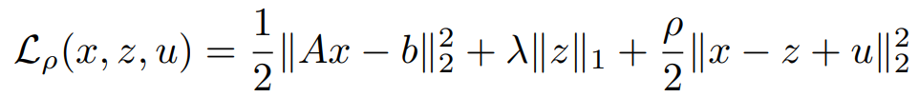
LASSO Reformulated for ADMM:
The general form of the Augmented Lagrangian used by ADMM is:
Using scaled dual variable u = y/ρ and modifying for ADMM:

Slide 15
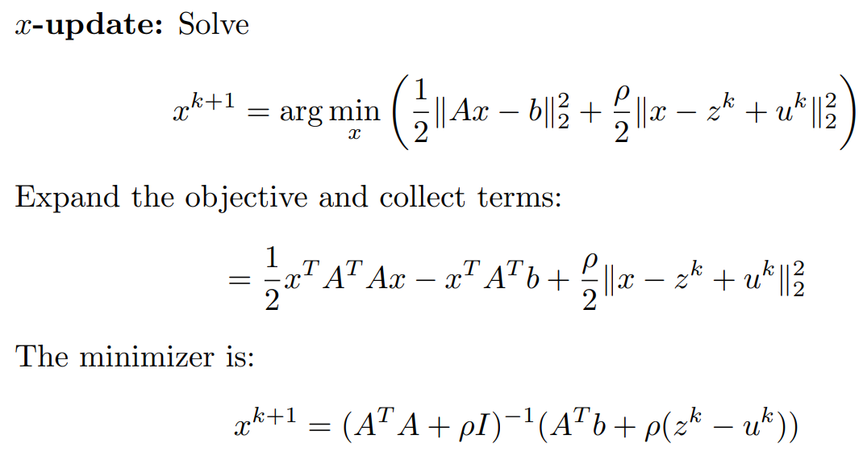
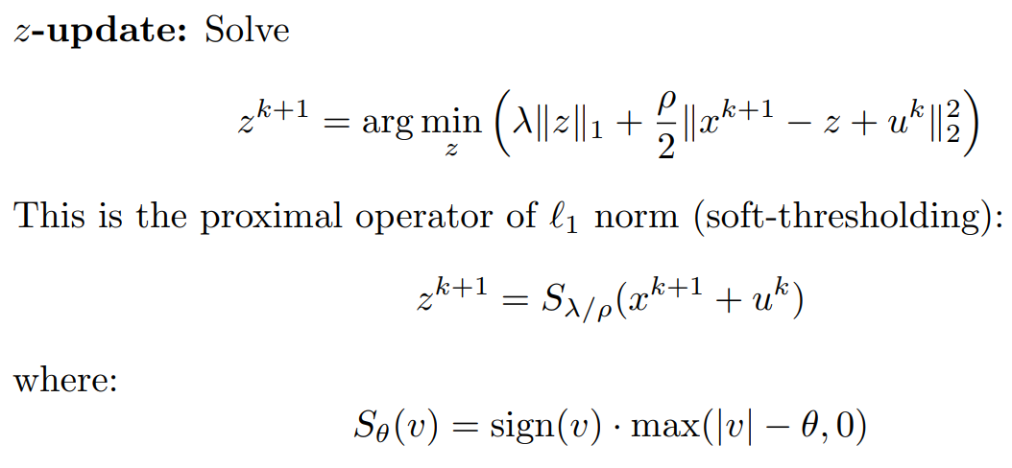
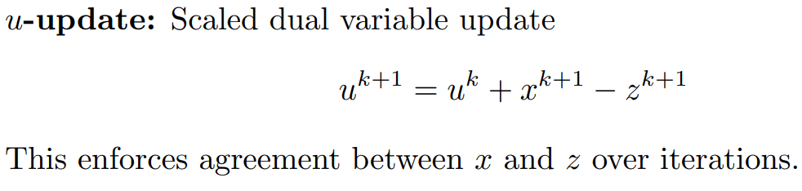
ADMM Iterative Updates for LASSO

Slide 16
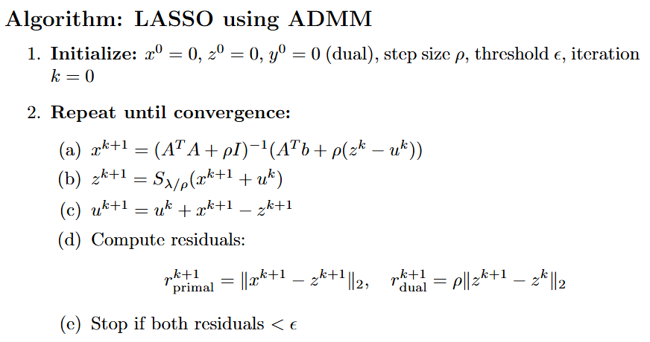

Slide 17
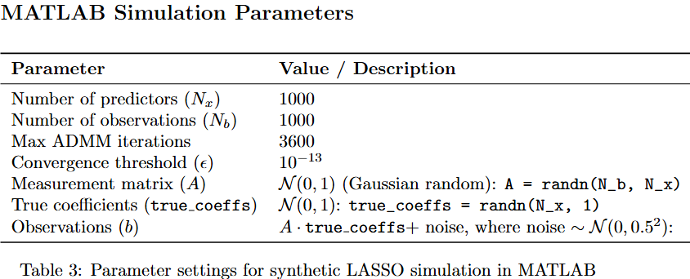

Slide 18
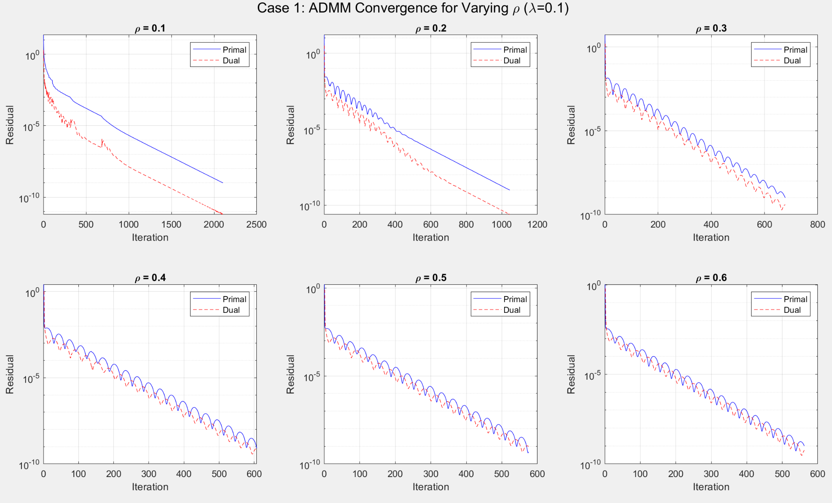

Slide 19
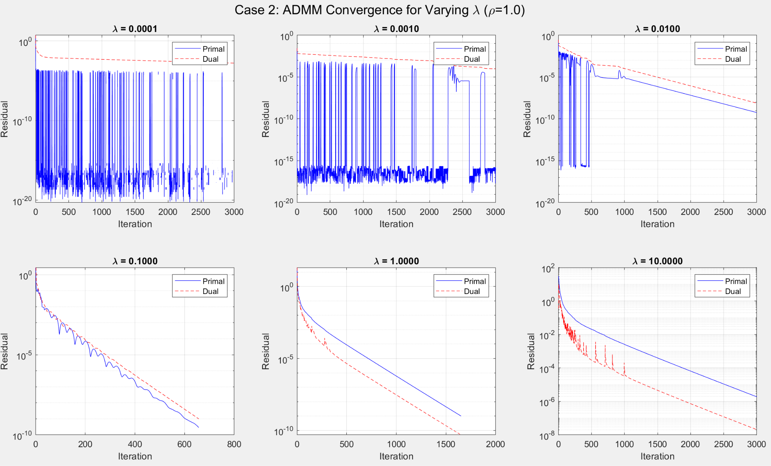

Slide 20
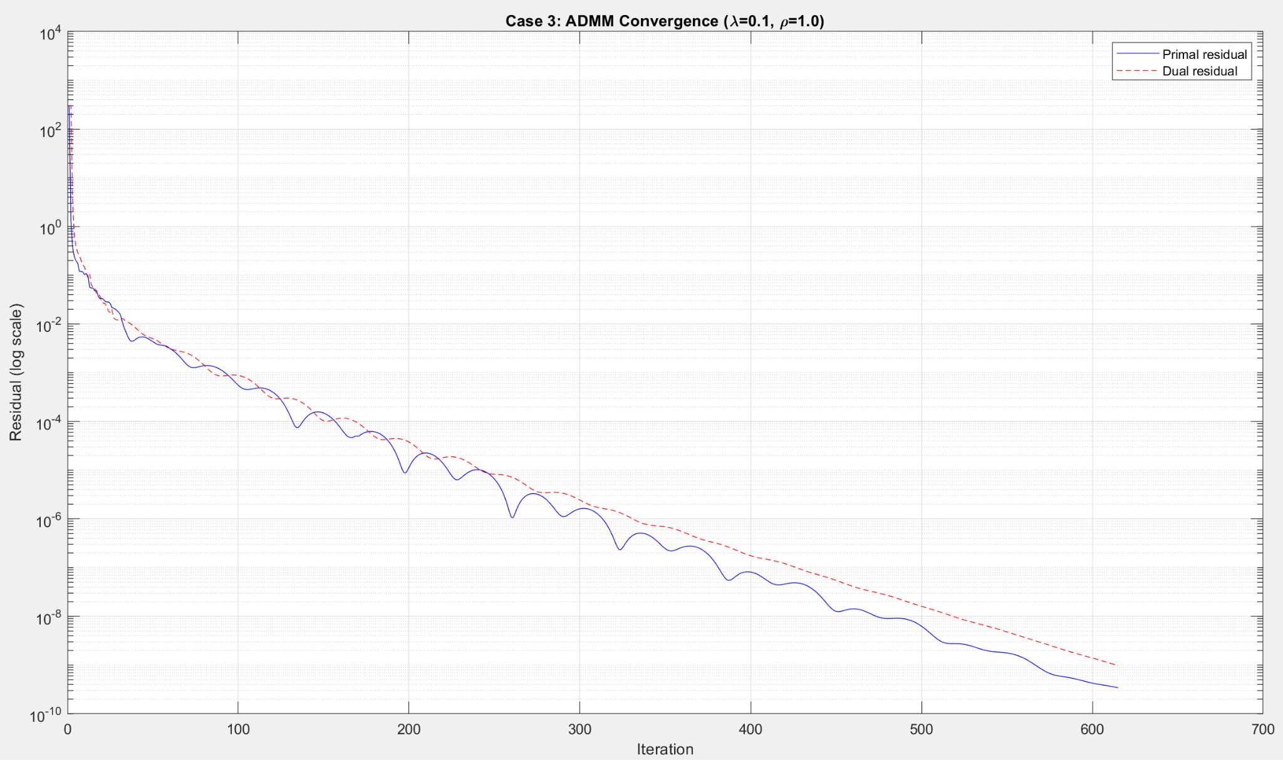

Slide 21
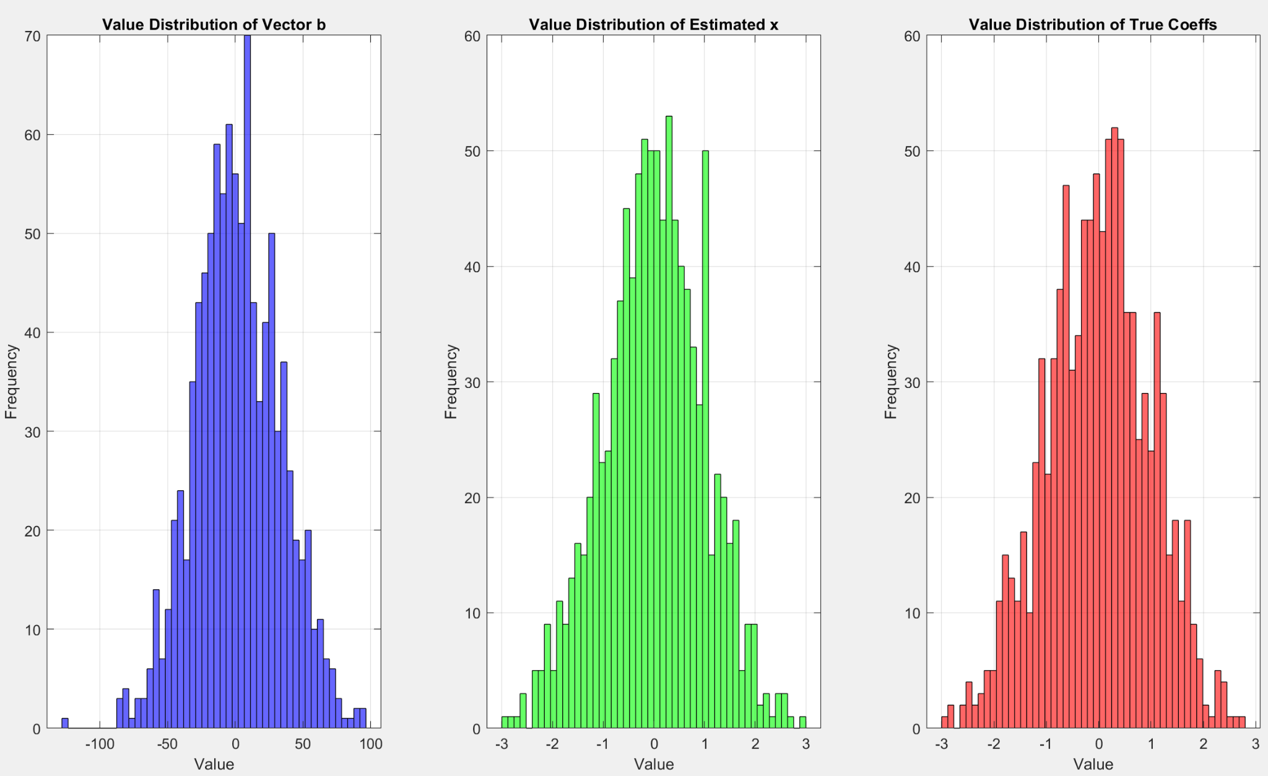

Slide 22
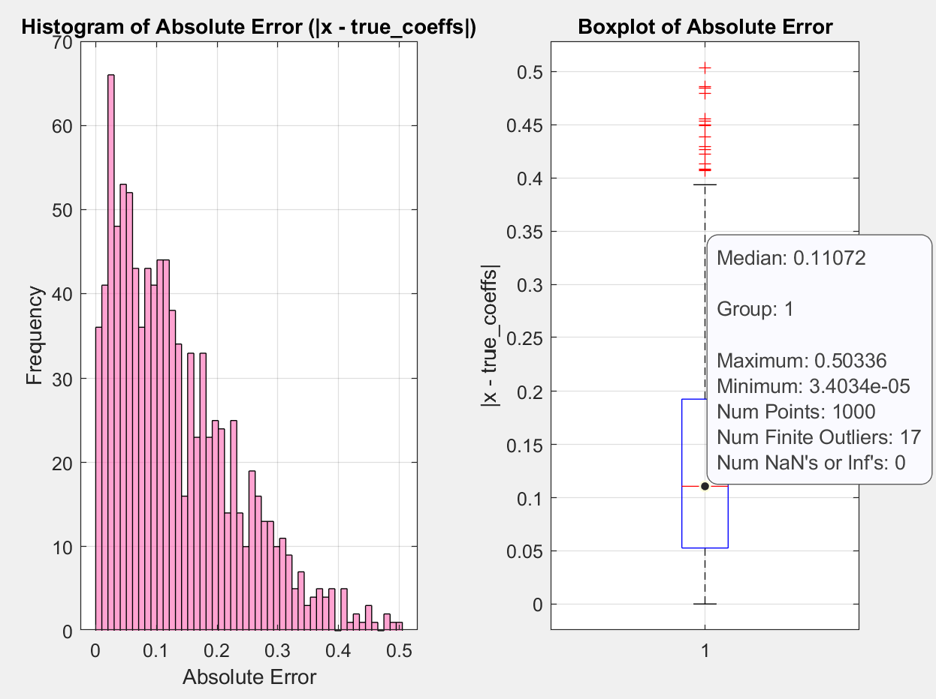
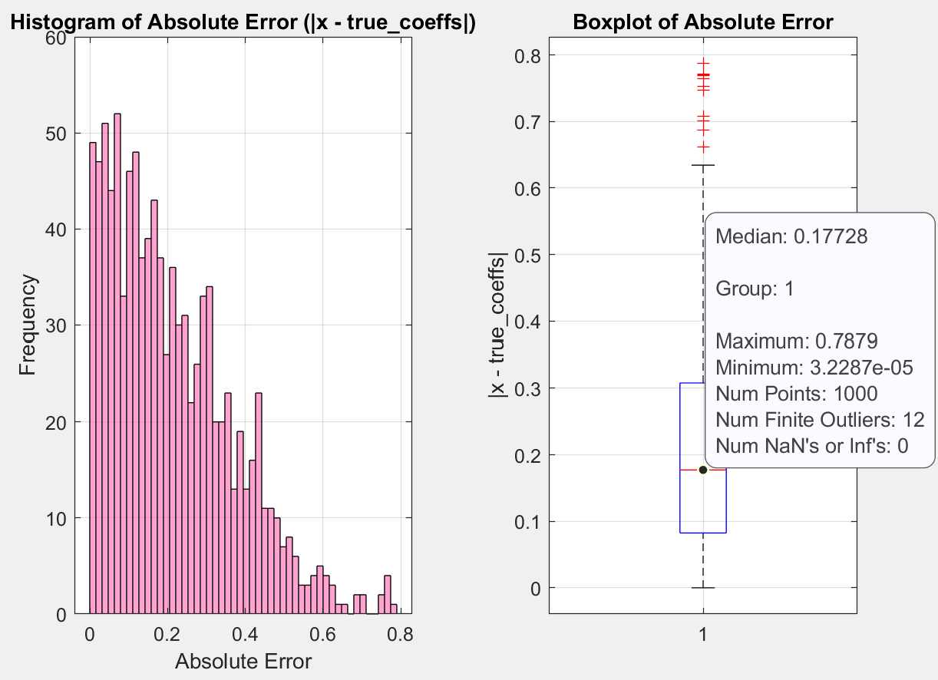
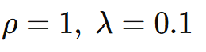
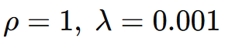

Slide 23
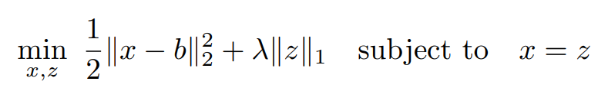
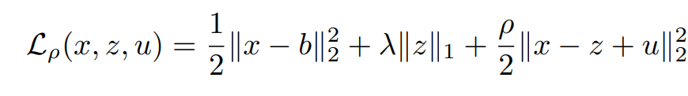
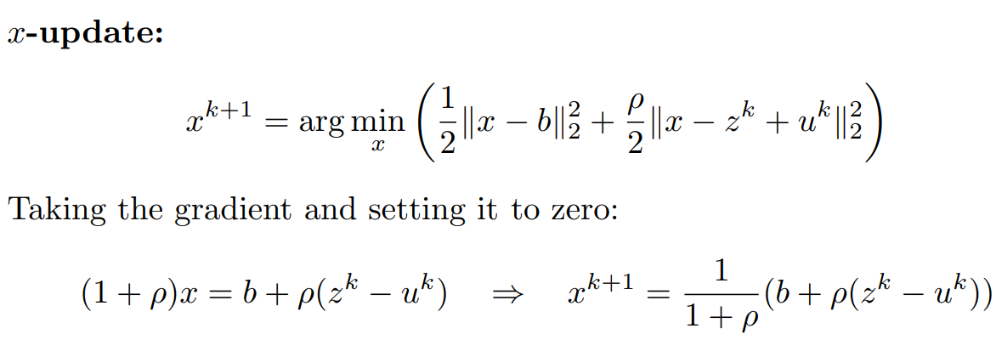
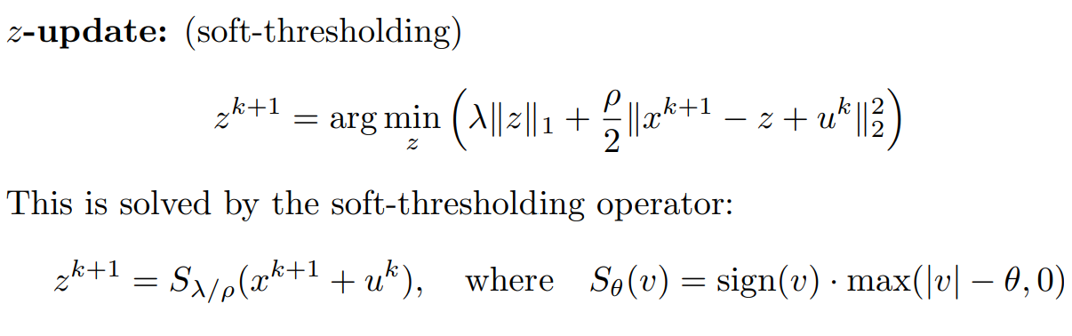
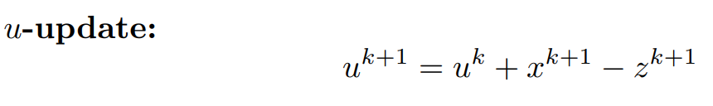
Case 2:Image Reconstruction Using ADMM for LASSO
When applying LASSO to image reconstruction using ADMM, A = I , which models a simple case where the noisy observation is a direct (but corrupted) version of the signal.

Slide 24
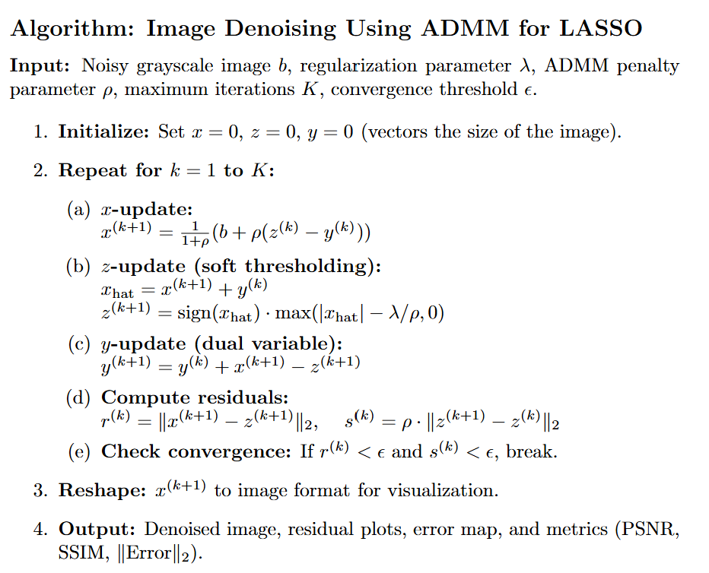

Slide 25
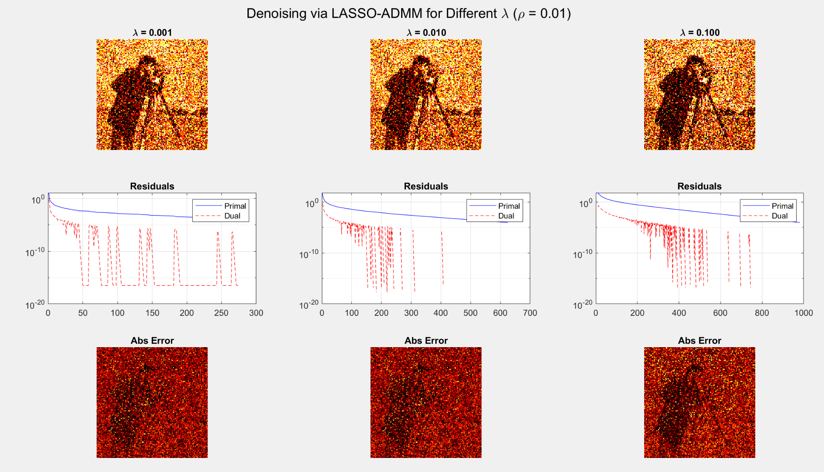

Slide 26
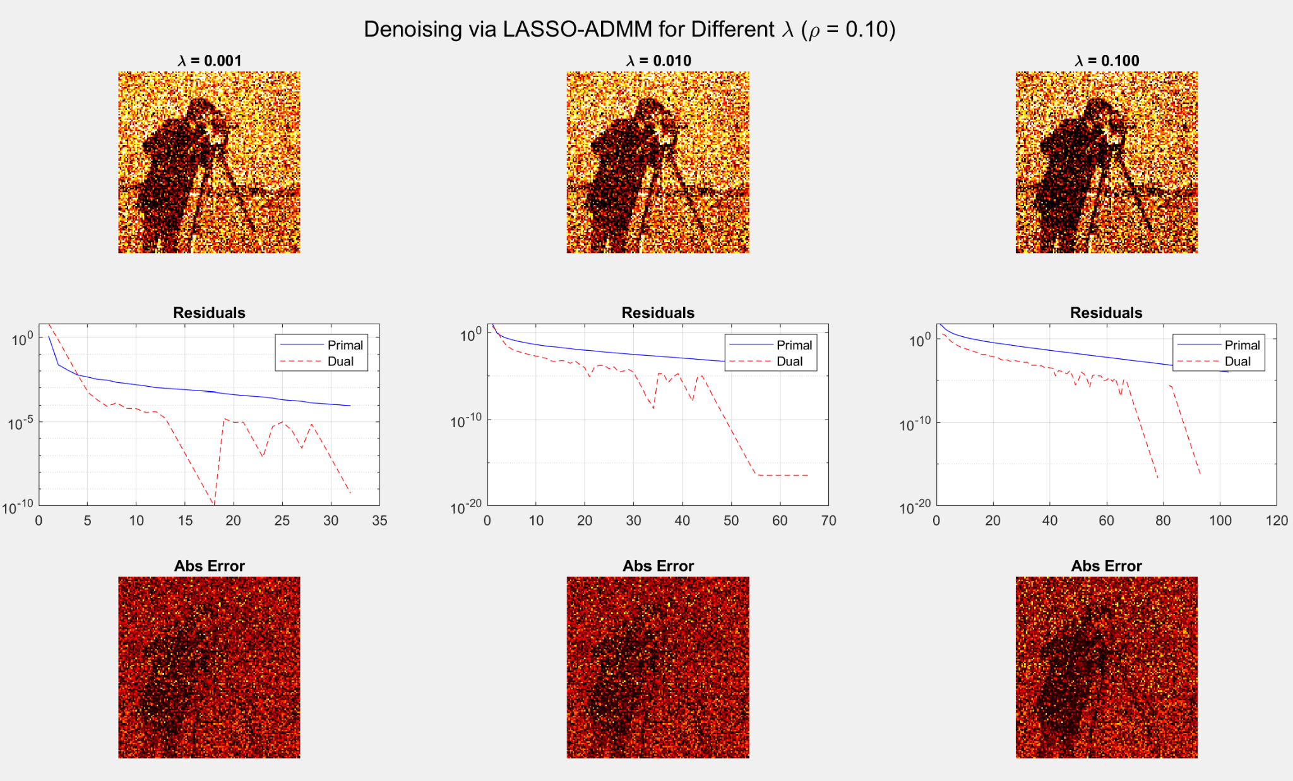

Slide 27
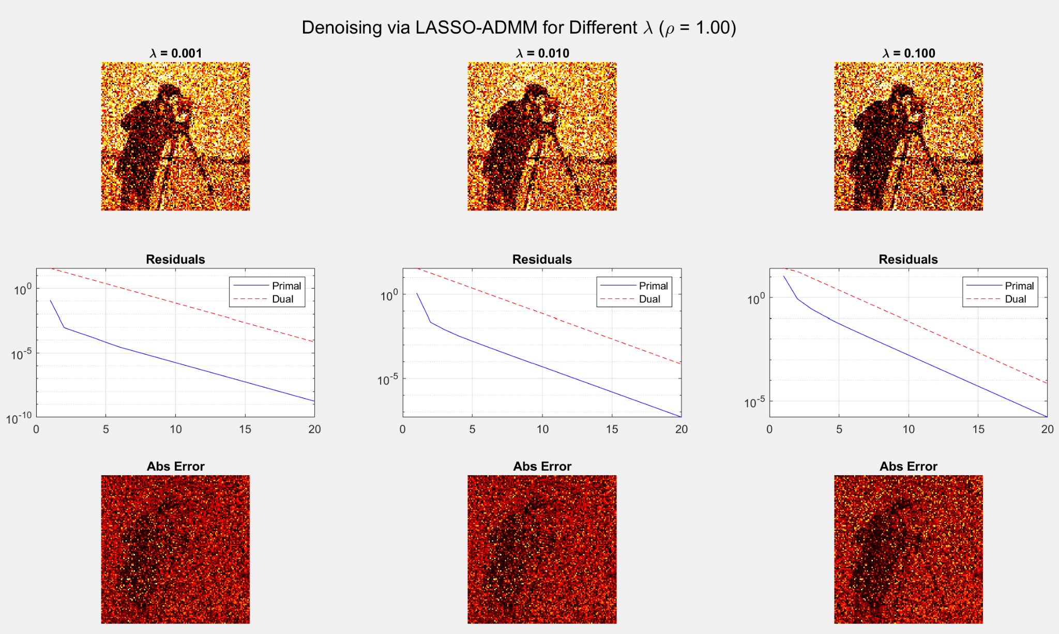

Slide 28
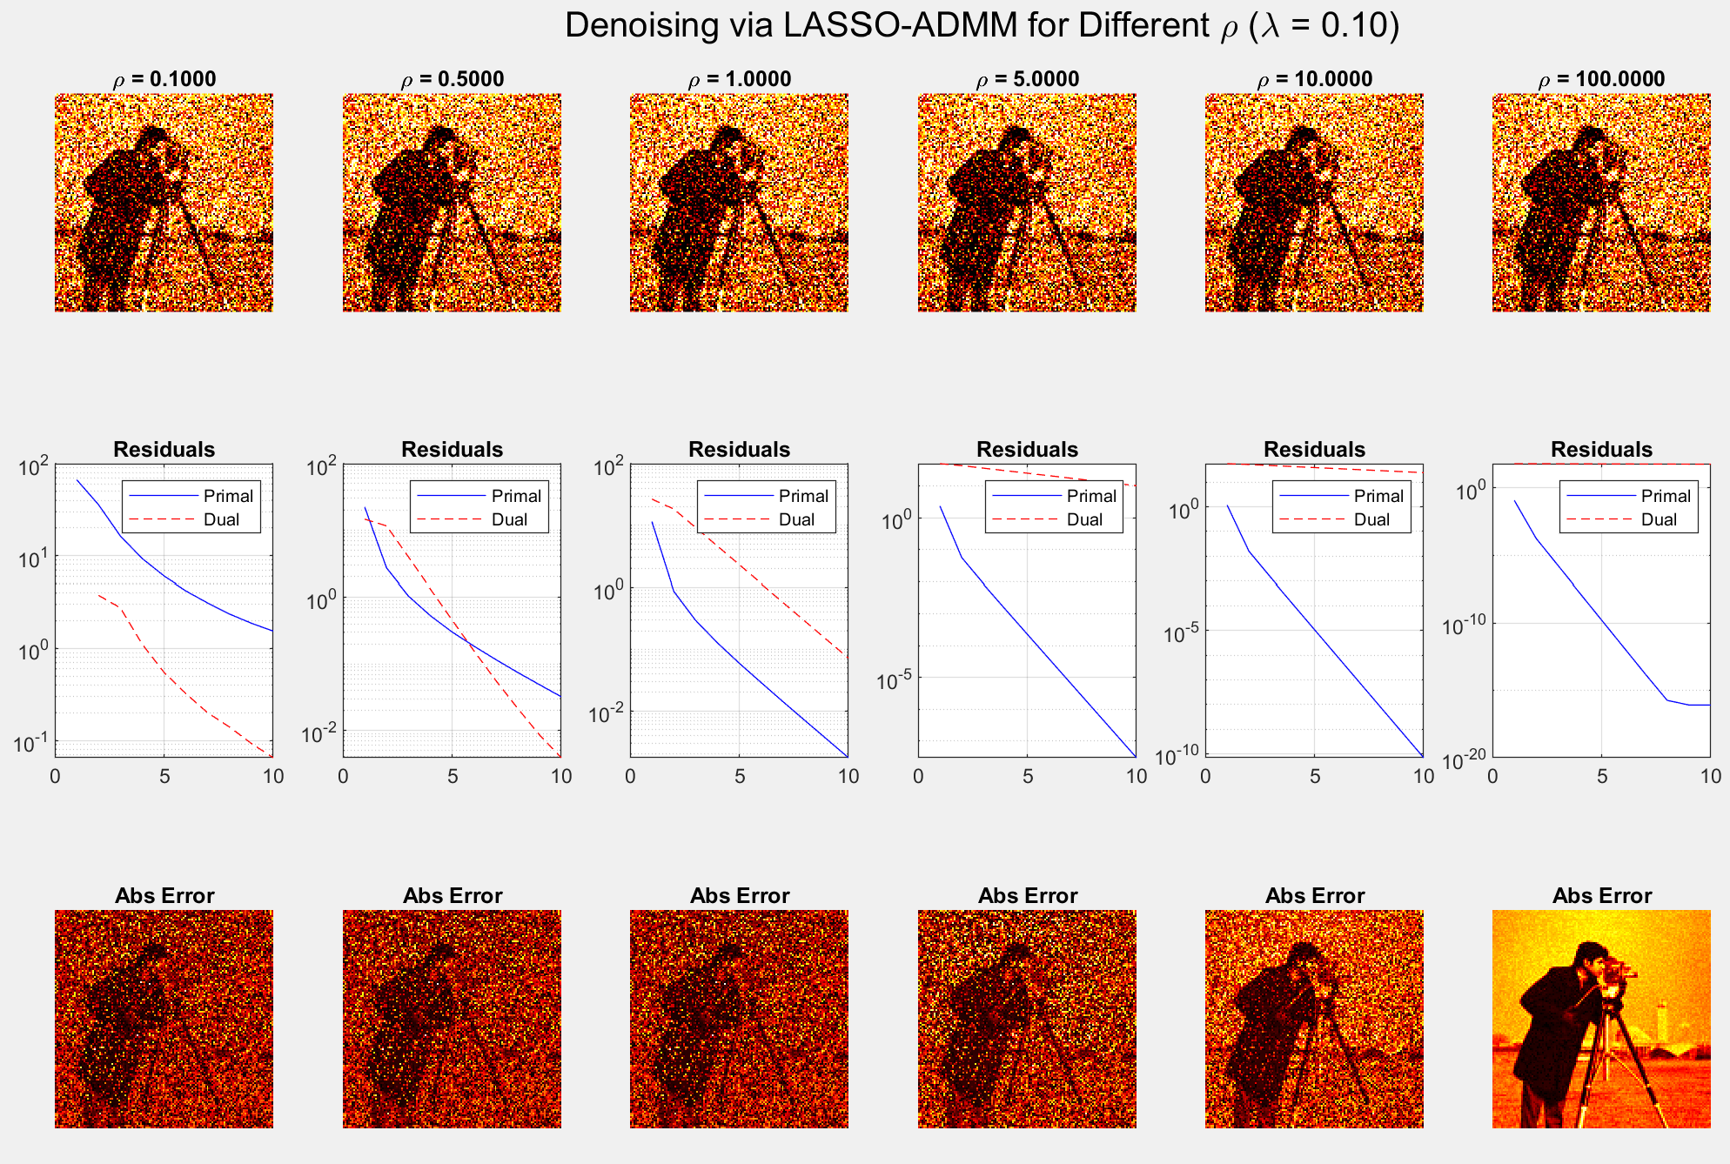

Slide 29
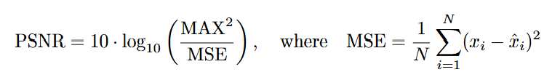
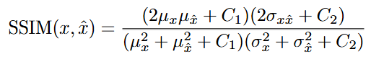
PSNR (Peak Signal-to-Noise Ratio): A logarithmic measure of the peak error between two images.
SSIM (Structural Similarity Index): Quantifies image similarity based on structural information, luminance, and contrast.

Slide 30
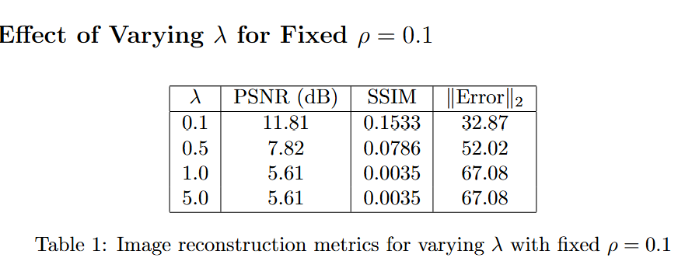
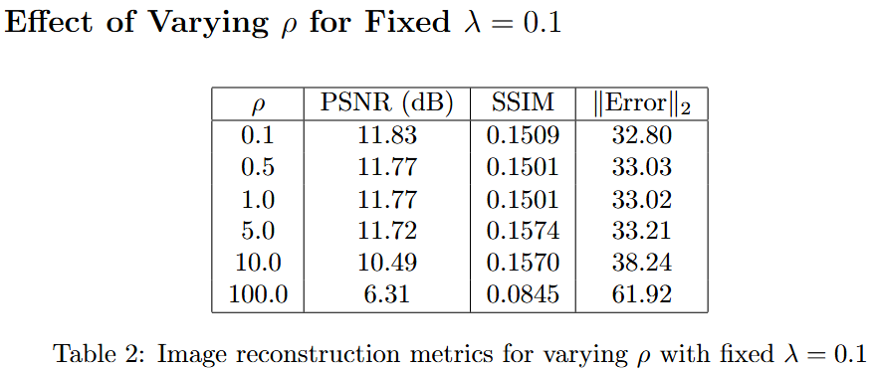

Slide 31
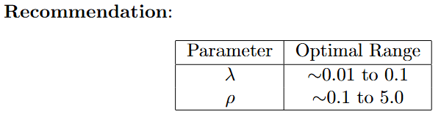
• There is a “sweet spot” where moderate values of λ and ρ yield best PSNR/SSIM.
• Too small λ under-regularizes (preserves noise); too large λ over-regularizes
(kills detail).
• Large ρ accelerates convergence but may cause poor estimates when λ is
also large.

Slide 32
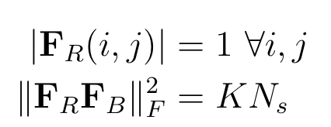
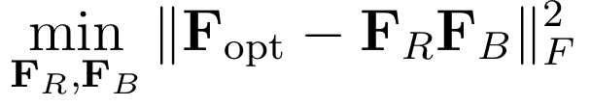
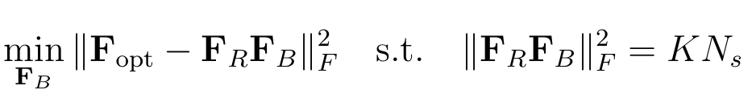
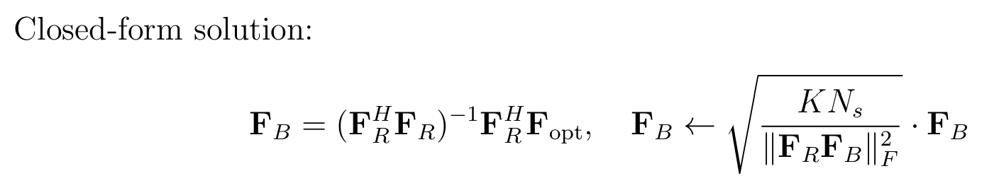

ADMM in precoder
To solve the Baseband precoder optimization subproblem, consider the objective:
To solve the RF precoder optimization subproblem, consider the objective:

Slide 33







ADMM:

Slide 34


Slide 35
Thank You!

